Slide 1
Building a Low Cost Mesh Network With LoRA

Slide 2
Table of Contents
1. Introduction
2. Understanding Mesh Networks
3. Overview of Meshtastic
4. Key Features of Meshtastic
5. Practical Applications
6. Challenges and Limitations
7. Future Developments
8. Conclusion

Slide 3
Introduction
Meshtastic is an innovative open-source project that combines low-cost, long-range radio hardware with GPS capabilities to create a decentralized mesh network for off-grid communication. Primarily leveraging LoRa (Long Range) technology, it allows users to send text messages and GPS locations over vast distances, far beyond traditional cellular networks. Each device in the network, or node, can relay messages, ensuring robust and resilient communication, especially useful in outdoor and emergency scenarios. Meshtastic's unique blend of low power consumption, extended range, and smartphone connectivity makes it an ideal solution for adventurers, emergency responders, and communities in remote areas seeking reliable, alternative communication methods.

Slide 4
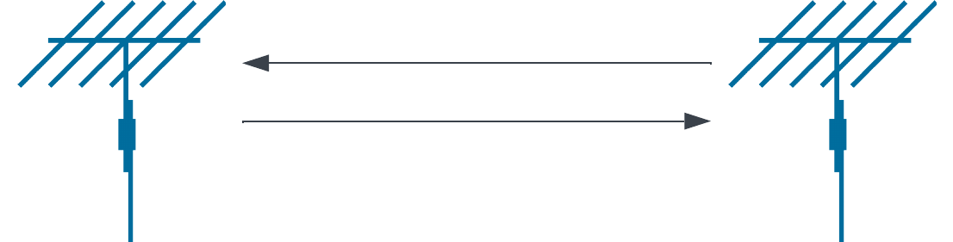
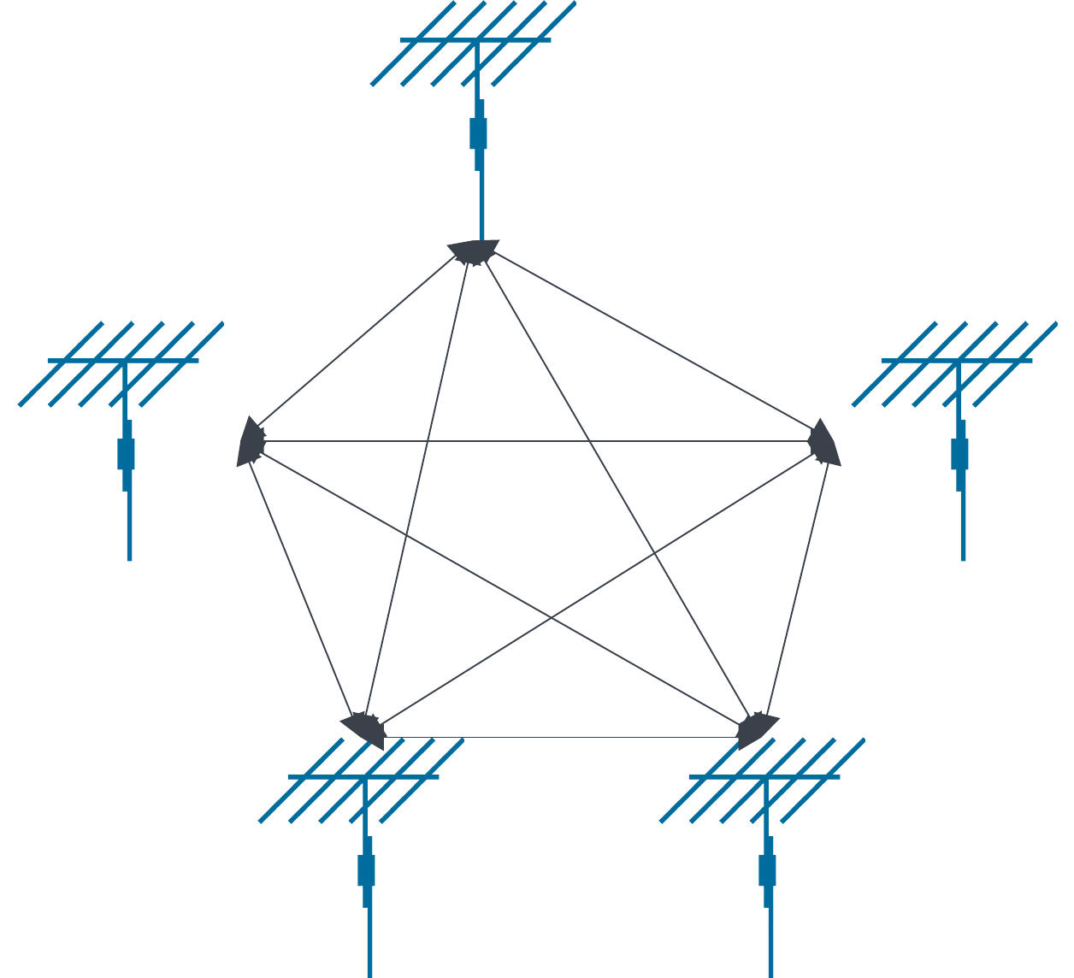
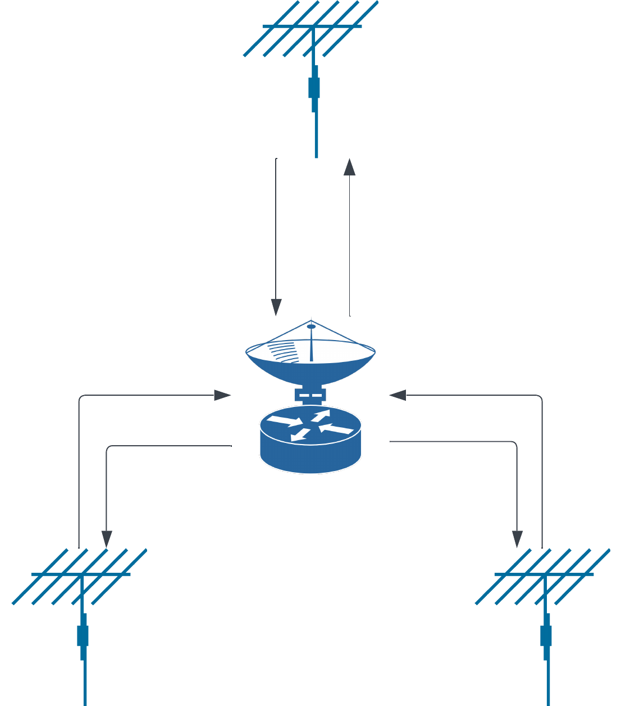
What Is A Mesh Network
Star Network
Simplex Network
Mesh Network
Notes:
Node-Based Communication: In a mesh network, each device (referred to as a 'node') is connected to several other nodes. Unlike traditional hub-and-spoke networks (like Wi-Fi or cellular networks), where each device connects to a central hub (router or cell tower), mesh networks allow direct device-to-device communication.
Dynamic Routing: Nodes in a mesh network dynamically determine the best path for data packets. When a node has a message to send, it uses an algorithm to decide which neighboring node it should send the message to, aiming for the message to eventually reach its destination.
Self-Healing: One of the key features of mesh networks is their ability to reconfigure themselves. If a node goes offline or is moved, the network can 'heal' by recalculating routes to ensure continuous operation.
Redundancy: Multiple potential paths between any two nodes in the network provide redundancy. If one path fails (for example, if a node loses power), the network can reroute traffic through different nodes.

Slide 5
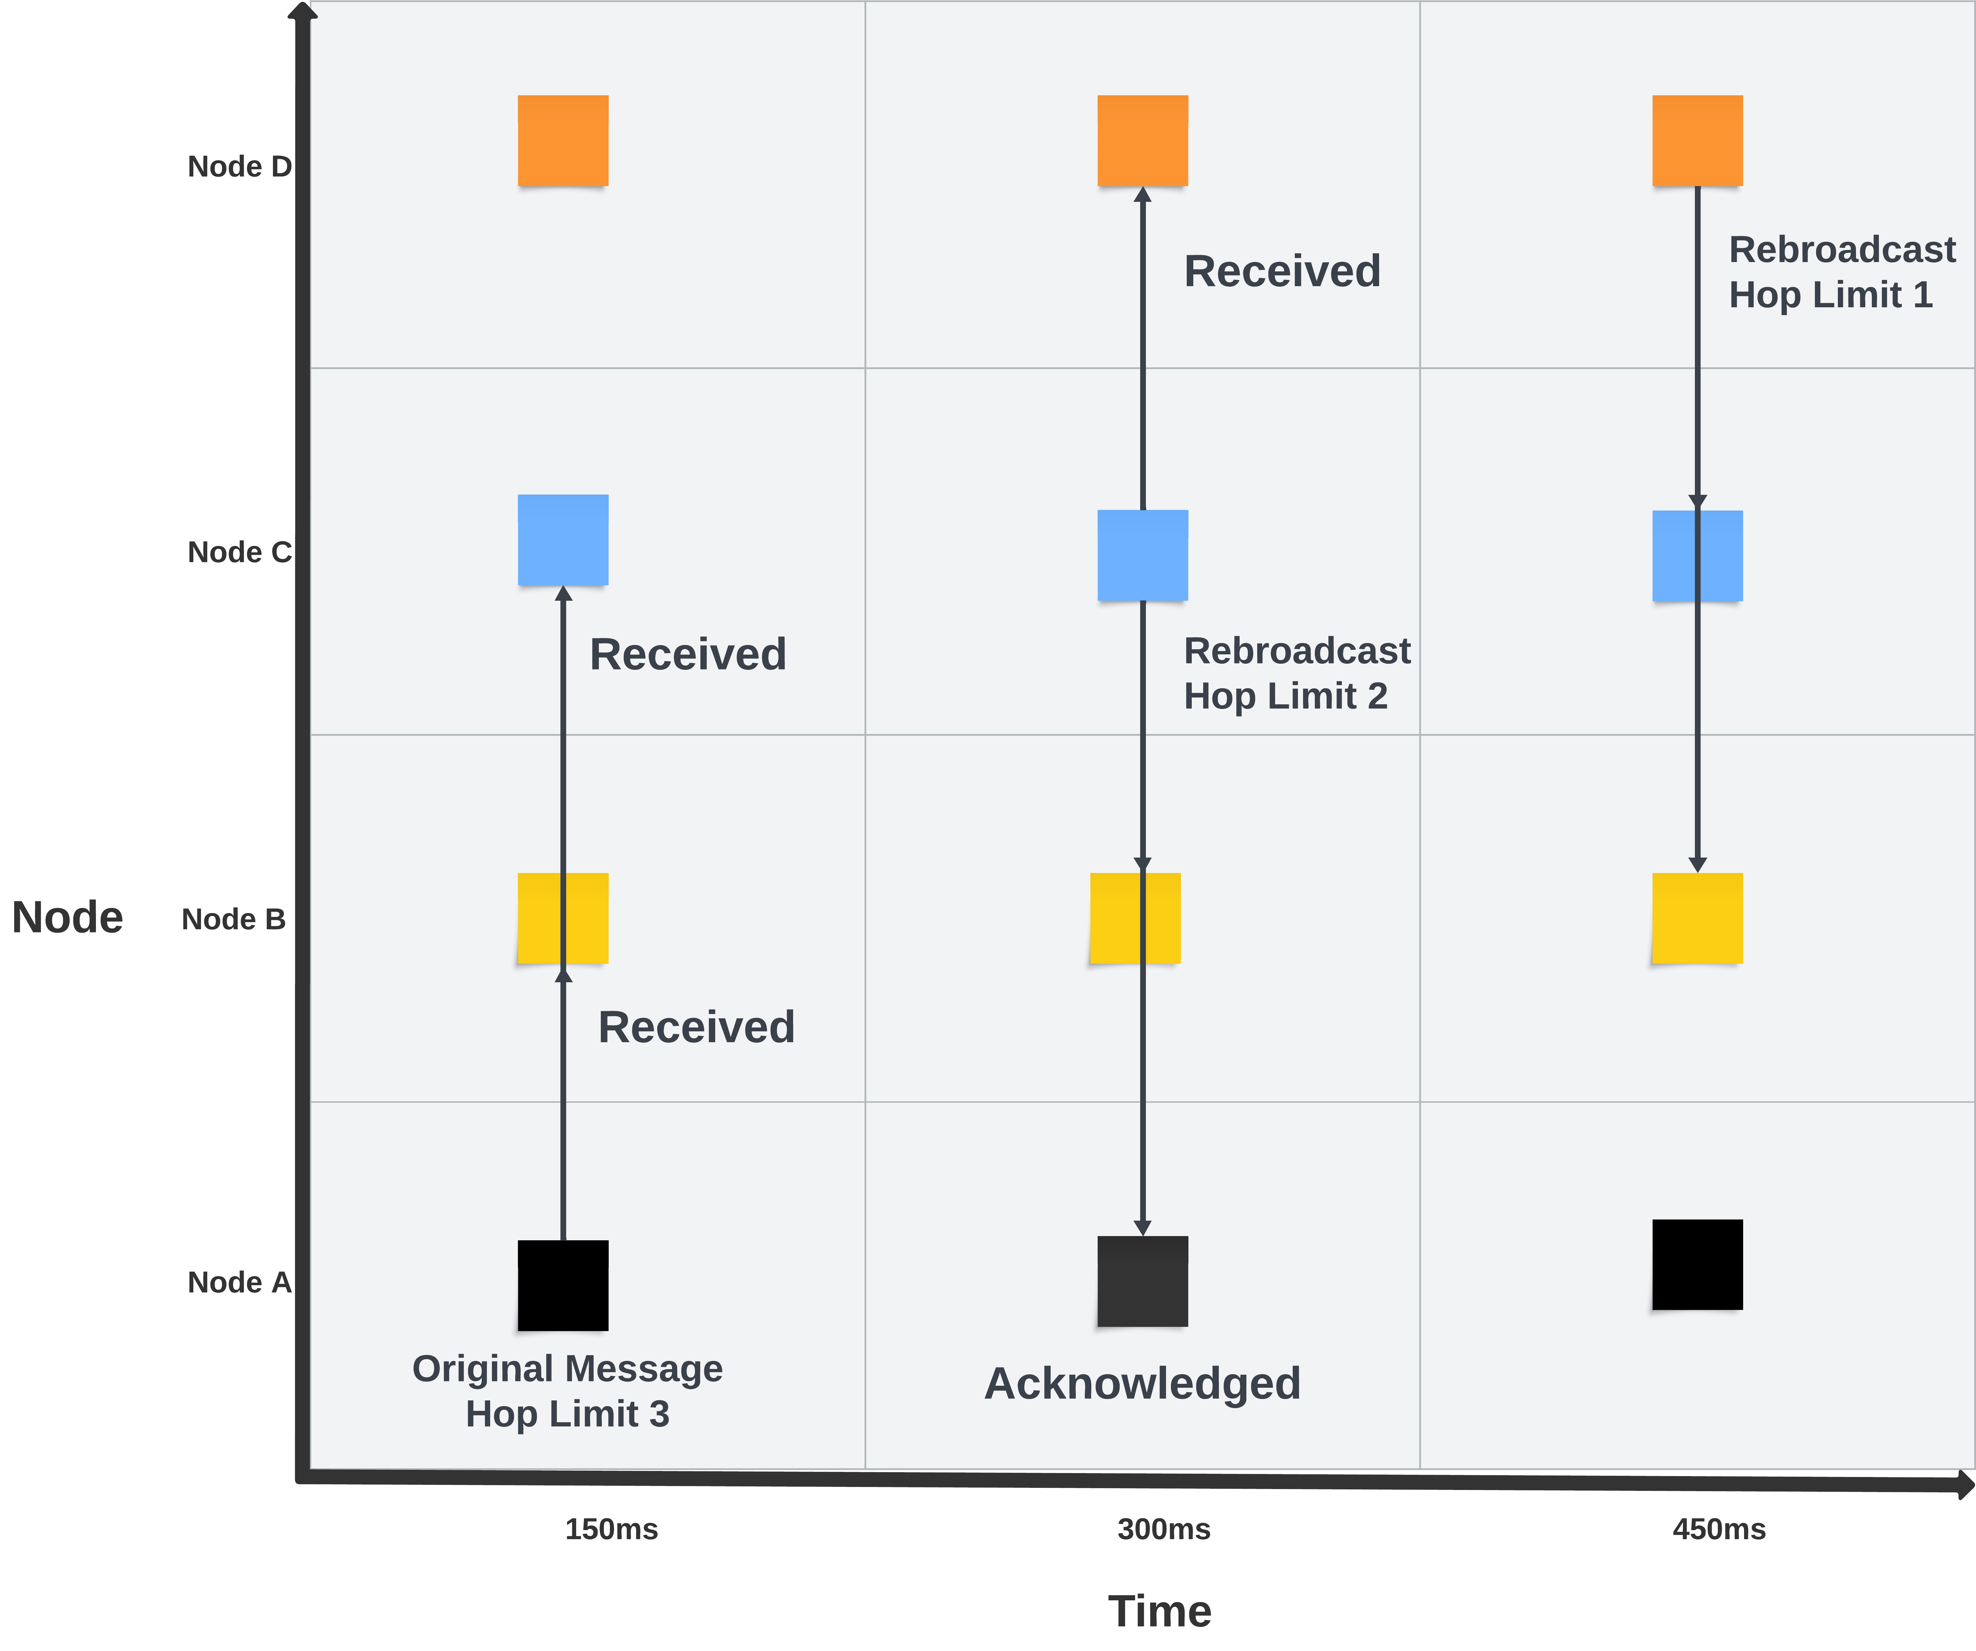
Meshtastic Theory of Operation
NodeA broadcasts a message to the mesh
NodeB receives the message
  Node1 checks the message SNR and delays rebroadcasting
NodeC receives the message
  Node2 rebroadcasts the message sooner that node1 due to the lower SNR, this acts as an ack for node0, and prevents node1 from rebroadcasting.
NodeD receives the message
  Node3 decrements the hoplimit number
  if its more than 0 it rebrodcasts and decrements
  If hoplimit is 0 it does nothing.

Slide 6
Encryption and Security
Encryption is implemented in devices/nodes with network-wide encryption keys. Stream cipher is AES256-CTR. Our AES key is 128 or 256 bits, shared as part of the 'Channel' specification.
Encryption is optional and is turned off when devices are in 'Ham mode'.
There is no encryption supported in the clients (iOS, Android) to facilitate distribution as mass market software.
Pairing from client-to-device is by:
  direct USB cable
  BT pairing
  Ethernet / wireless network
Devices are 'promiscuous' and will pair with any near-by client. Network confidentiality requires physical protection of all nodes.

Slide 7
Use Cases
Off grid communication
  Long range communication in remote areas
  Send location data in case of emergency
  Easily deployable remote self contained router nodes
Remote sensors / actuators
  Farm water level monitoring
  Remote sensors send data to a central MQTT server for logging
Encrypted local messaging
  Communicate in Cellular / internet denied areas
  Secure messaging / PSK can be rotated
  MQTT can be used to securely connect meshes over long distances

Slide 8
Technical Details
Max message size
  256 bytes total
    Low Level Header: 16 bytes
    Node UUID: 3 bytes
    Available Message size: 237 bytes
App / API
  Android and iOS apps
  Python API
  MQTT
Max range
  Maximum tested range is 254km (158 miles)
  Max of 50 – 100 nodes depending on available RAM
Power
  Varies by hardware, TBEAM 3v 180ma max (GPS, Transmit, and display on)
  Most include battery charging circuit
  Often include input for solar panels

Slide 9
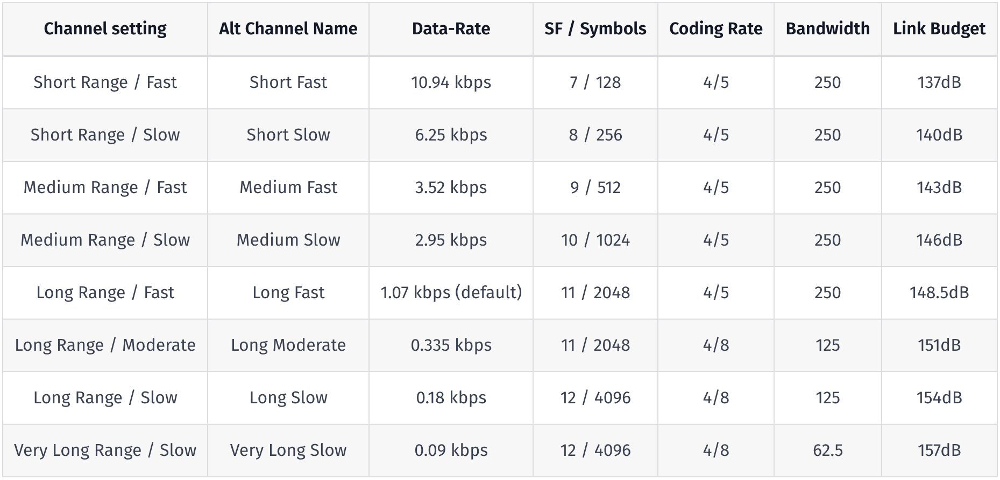
Bandwidth

Slide 10
Hardware Options
Lilygo
  T-Beam (ESP32)
  T-echo (nRF52840)
  LoRA (ESP32)
  T-Deck (ESP32, AIO)
  T-Watch (nRF54280, wearable)
Station
  G1 (ESP32, for licensed HAMs)
  Nano G2 / Explorer (mobile)
RAKwireless
  RAK4631 (nRF52840)
  RAK11200 (ESP32)
  RAK11310 (RP2040)
Radios
  All use SX12xx LoRA radios
  ISM 915mhz, 858mhz bands
Cost
  Prices vary, most nodes between $30 and $100

Slide 11
Example Fixed Node
IP65 Waterproof Enclosure 156 x 90 x 60 mm - $10
  https://www.amazon.com/gp/product/B07H5GS8VY/ref=ppx_od_dt_b_asin_title_s00?ie=UTF8&psc=1
10 Ah Lithium Ion Battery - $27
  https://www.amazon.com/gp/product/B07S75HC2H/ref=ppx_od_dt_b_asin_title_s00?ie=UTF8&psc=1
Bulkhead SMA Connector - $8
  https://www.amazon.com/gp/product/B07BXZ2NDV/ref=ppx_od_dt_b_asin_title_s00?ie=UTF8&psc=1
5v 1A Solar Panel with Regulator - $14
  https://www.amazon.com/gp/product/B099RSLNZ4/ref=ppx_od_dt_b_asin_title_s00?ie=UTF8&th=1
Bulkhead Gland - $10 (20x)
  https://www.amazon.com/gp/product/B085NVDC3K/ref=ppx_yo_dt_b_asin_title_o06_s00?ie=UTF8&psc=1
5.8dbi 915mhz Omni antenna - $53 (1x)
  https://www.amazon.com/gp/product/B09TZVQ4F7/ref=ppx_yo_dt_b_asin_title_o07_s00?ie=UTF8&psc=1
Ulkhead IP65 momentary pushbutton - $10 (6x)
  https://www.amazon.com/gp/product/B08R9P3RKM/ref=ppx_yo_dt_b_asin_title_o04_s00?ie=UTF8&psc=1
Lilygo LoRA32 - $32
  https://www.amazon.com/gp/product/B09SHRWVNB/ref=ppx_yo_dt_b_asin_title_o08_s00?ie=UTF8&psc=1
6” SMA male to male extender - $9
  https://www.amazon.com/gp/product/B0C34KL463/ref=ppx_yo_dt_b_asin_title_o02_s01?ie=UTF8&psc=1
Total: $146.70

Slide 12
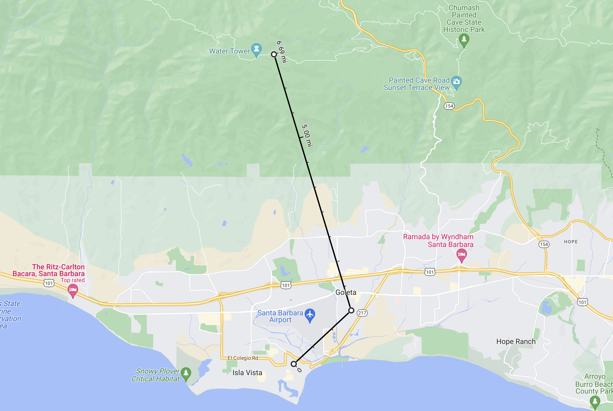
Existing Network

Slide 13
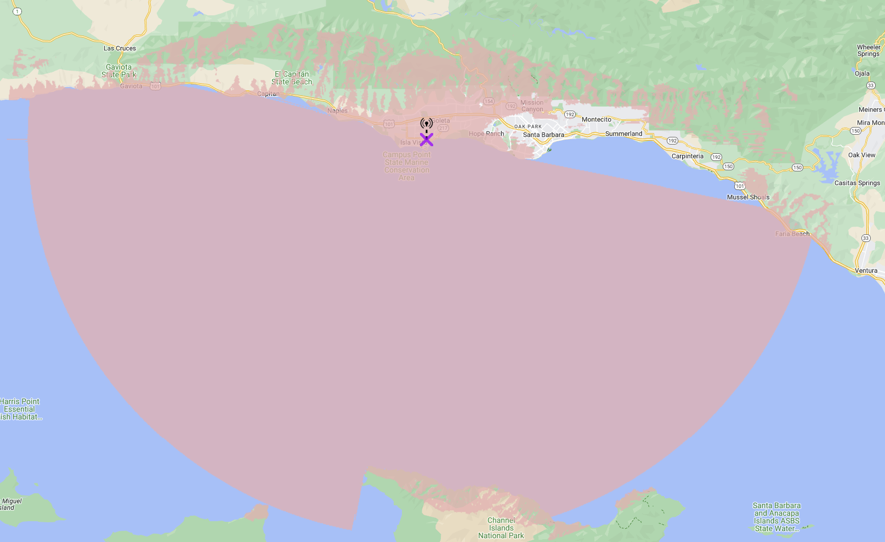
Approximate Coverage From UCSB

Slide 14
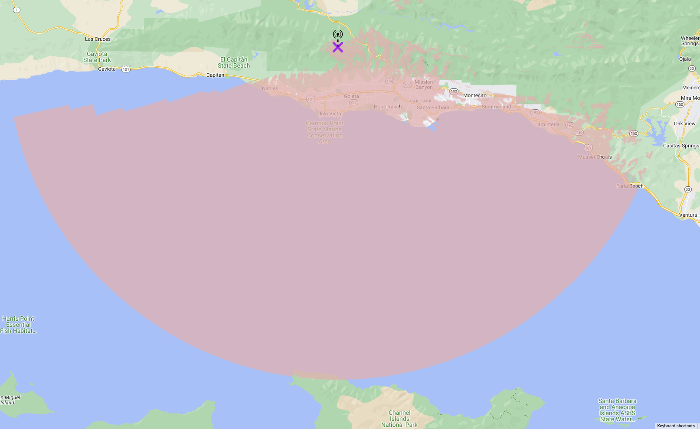
Approximate Coverage From E. Camino Cielo

Slide 15
References
https://meshtastic.org/docs/introduction
https://github.com/meshtastic
https://github.com/GUVWAF/Meshtasticator
https://meshtastic.org/docs/overview/range-tests
https://en.wikipedia.org/wiki/LoRa

